Slide 1






Tools and Lab
Results
Conclusion
Research Question

Slide 2




Research Question

Slide 3

What’s QUIC?
"Quick UDP Internet Connections“ _____________________________________
QUIC improves performance of connection-oriented web applications that are currently using TCP. It does this by establishing a number of multiplexed connections between two endpoints over User Datagram Protocol (UDP).

Slide 4

Why it’s Interesting?
We have been using QUIC unconsciously for several years now.
Google Corporation and some recent researches claim that QUIC has reduced the latency of Google search responses by 3.6% and YouTube video repositories by 15.3%.
Google has a clear motive for promoting the QUIC protocol and is very hard to resist.
The studies produce biased results, especially those that Google wants us to be exposed to.

Slide 5
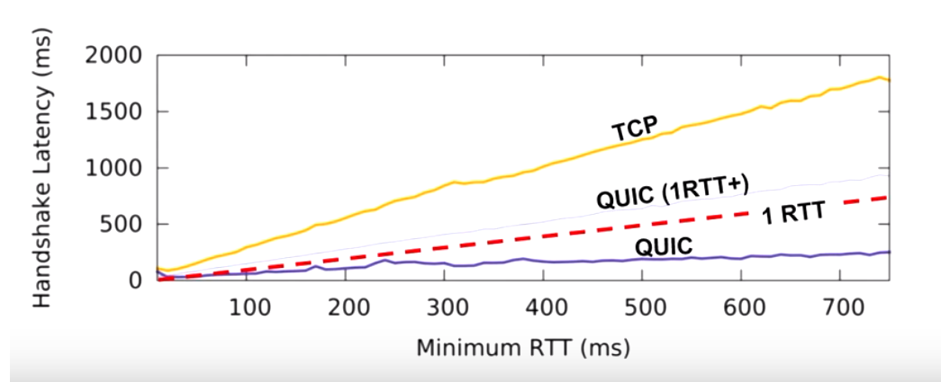

Knowledge
Since the QUIC protocol is consistently updating, the old researches doesn’t reflect the authentical performances.
In addition, most of the research's which sideways QUIC are published by googles teams or appear in Google scholar.

Slide 6
The QUIC Transport Protocol: Design and Internet-Scale Deployment (2017) – Google research
Taking a long look at QUIC (2017) – A. Molavi Kakhki et al.
A First Look at QUIC in the Wild (2018) – TU Berlin
How Quick is QUIC? (2017) – Budapest University

Slide 7




Tools and Lab

Slide 8

Why the environment is so complicated?
gQUIC protocol that implements by Google works only on a Google client (Chrome) and servers (still no use for IETF QUIC - iQUIC )
QUIC open source getting update constantly and doesn’t necessarily equal to the gQUIC.
QUIC protocol using TLS1.3 – all the connections through the tests should be secured with certificates.
The test scenario should be equal with HTTP2.0 for comparation.

Slide 9
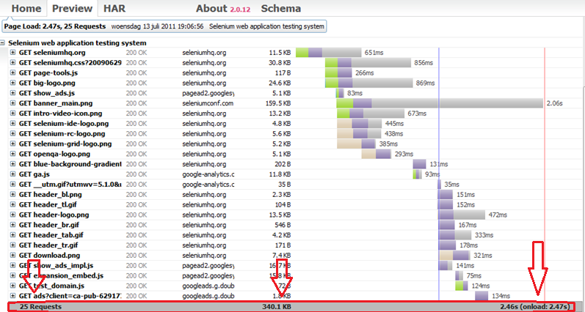
.HAR file:
The HTTP Archive format, or HAR, is a JSON-formatted archive file format for logging of a web browser's interaction with a site. The common extension for these files is .HAR.

Slide 10

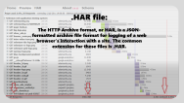
Our lab & tools:
We measure 3 things in every entry:
Number of requests
Total weight
Total time
After verifying that the browser use the QUIC protocol only when set in the profile configuration, we looked at 3 test cases:
1. Run on a virtual machine with WiFi connection
2. Run on a virtual machine with an Ethernet connection
3. Run on Linux with an Ethernet connection
In each test case we made 3000 entries to Google server (YouTube) using the QUIC protocol and 3000 identical entries without the experimental protocol (using HTTP 2.0)

Slide 11


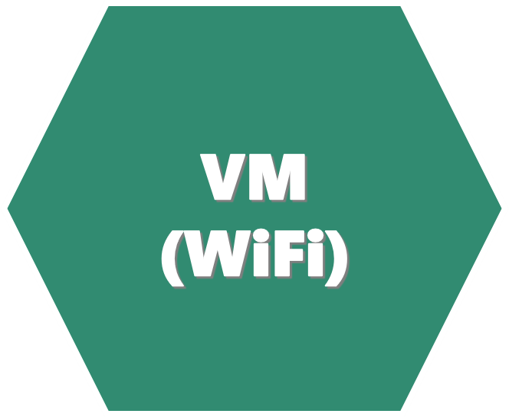
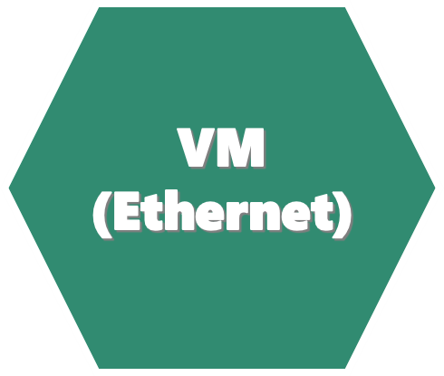
RESULTS

Slide 12
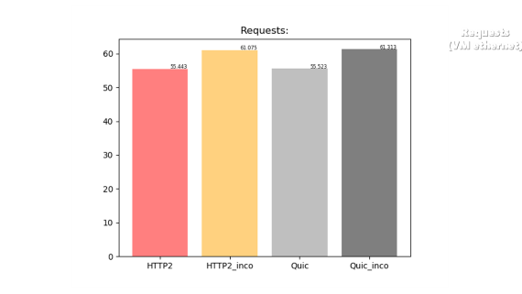
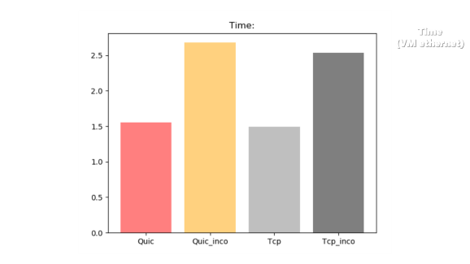
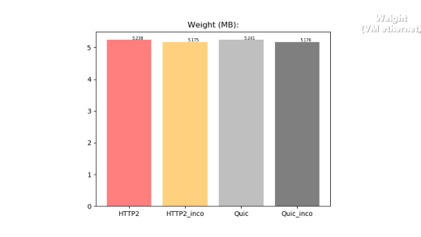
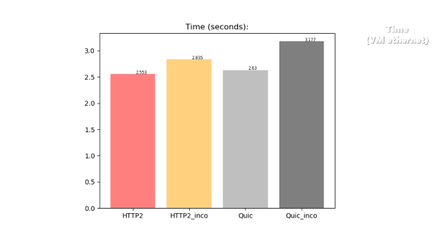
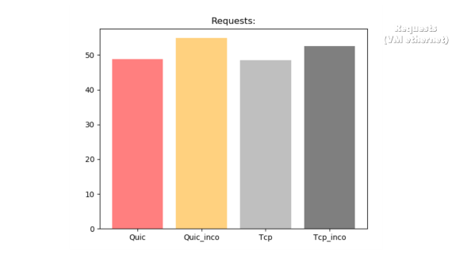
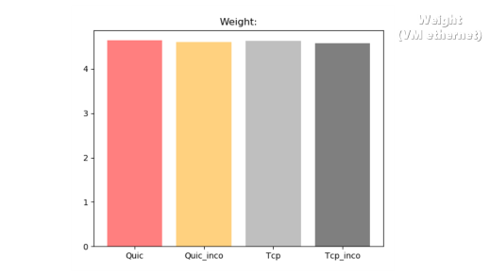
VM (Ethernet)
Weight
Time
Requests

Slide 13
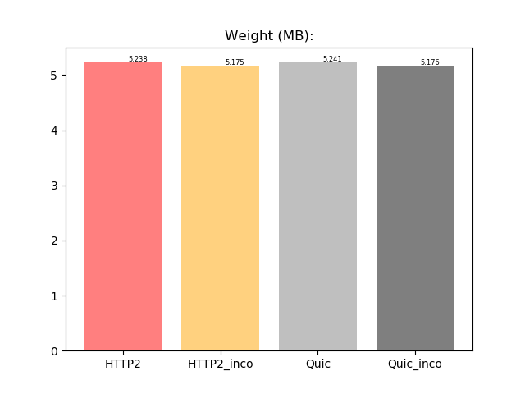
Weight
(VM ethernet)

Slide 14
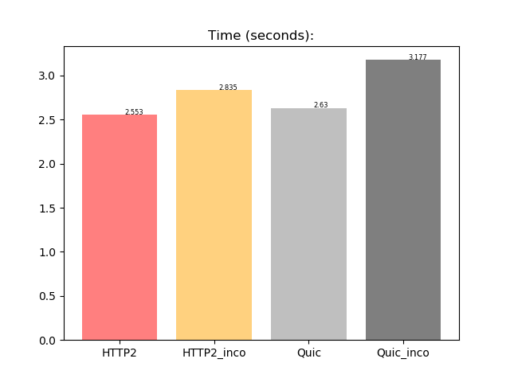
Time
(VM ethernet)

Slide 15
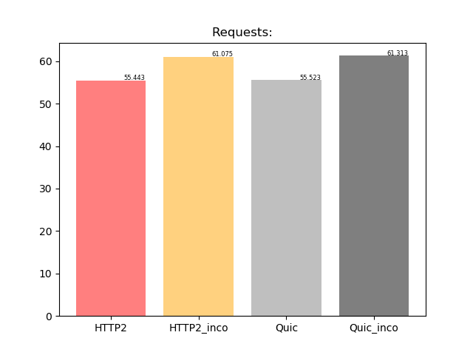
Requests
(VM ethernet)

Slide 16
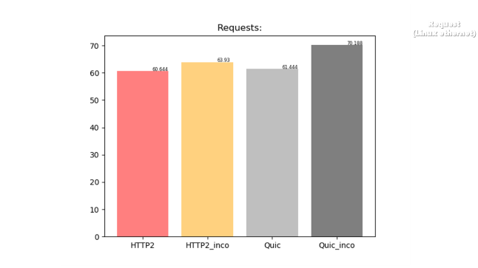
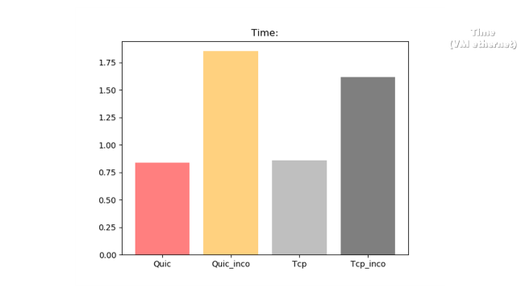
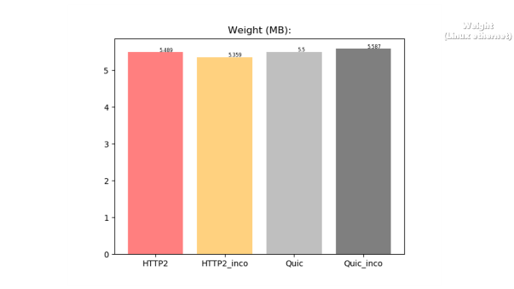
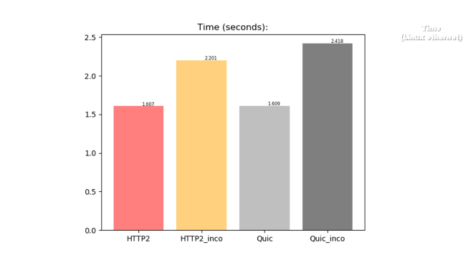
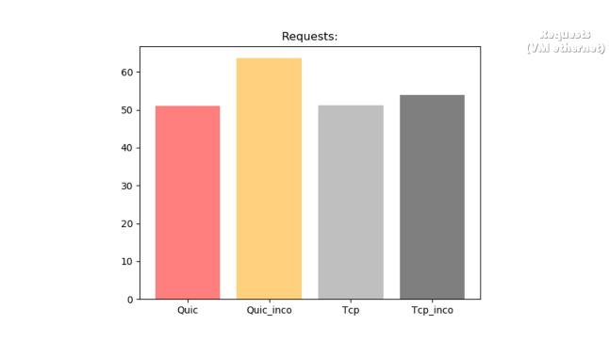
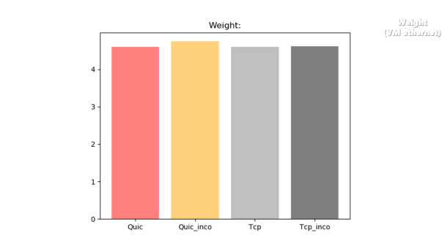
Linux (Ethernet)
Weight
Time
Requests

Slide 17
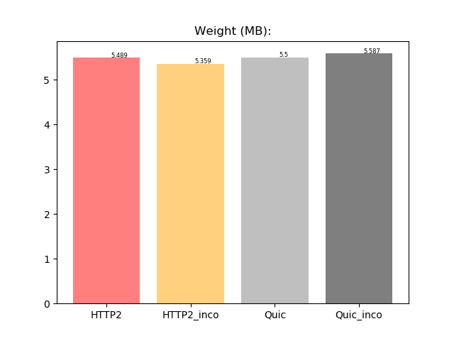
Weight
(Linux ethernet)

Slide 18
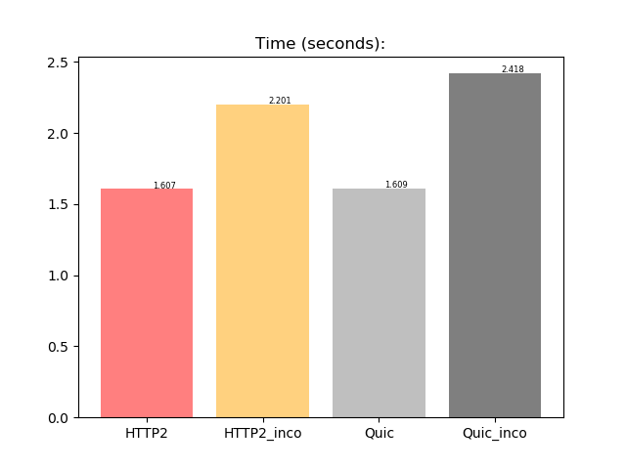
Time
(Linux ethernet)

Slide 19
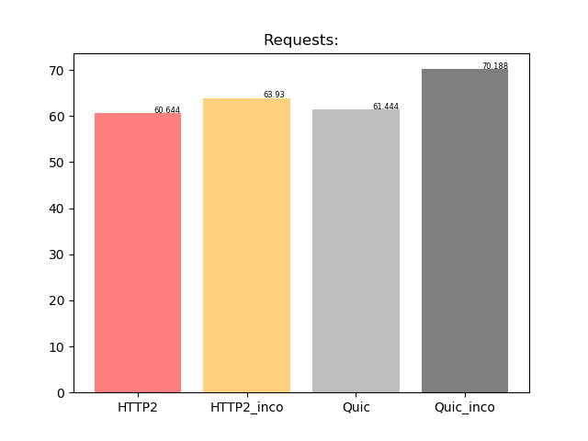
Request
(Linux ethernet)

Slide 20
VM (WiFi)
Weight
Time
Requests

Slide 21
Weight
(VM ethernet)

Slide 22
Time
(VM ethernet)

Slide 23
Requests
(VM ethernet)

Slide 24



Conclusion

Slide 25

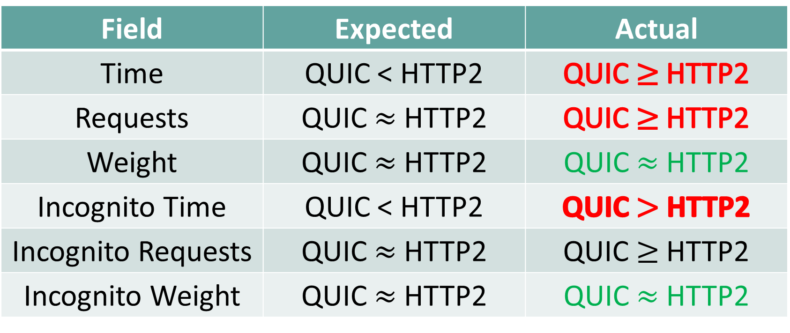
Expected Vs. Actual:
Actual | Expected | Field
QUIC$≥$ HTTP2 | QUIC < HTTP2 | Time
QUIC$≥$ HTTP2 | QUIC $≈$ HTTP2 | Requests
QUIC $≈$ HTTP2 | QUIC $≈$ HTTP2 | Weight
QUIC$>$ HTTP2 | QUIC < HTTP2 | Incognito Time
QUIC$≥$ HTTP2 | QUIC $≈$ HTTP2 | Incognito Requests
QUIC $≈$ HTTP2 | QUIC $≈$ HTTP2 | Incognito Weight
WHY??

Slide 26
Future Work
Extra wide research –
Check the same metrics in other data centers (globally).
Check the protocol on mobile devices.
Packet Loss scenario
Why the number of requests in QUIC is larger than HTTP2
Examine GQUIC implementation VS IQUIC
More parameters

